Slide 1
Life Protection AdvantageSM IUL
Help Your Clients Get Protection Through Life
Notes:
Moving into a new home. Celebrating accomplishments. First steps. First bicycle. First day of school.
These are just some of the milestones of your clients’ lives. They wouldn’t want to miss any of them. But if they can no longer share them with their family, you know they would want their loved ones to have the financial protection that will help them carry on with their lives.
That’s where a Life Protection Advantage indexed universal life insurance policy comes in. The death benefit can help the insured provide for his or her loved ones and maintain their standard of living – even if the insured is no longer around.

Slide 2
Protection that’s guaranteed
Focused on providing a long-term death benefit
Long-term no-lapse protection premium
Available up to issue age 75
Guarantees coverage to age 85
Short-term no-lapse protection premium
Minimum initial premium payment
Guarantees coverage: – 10 years for ages 0-75 – to age 85 for ages 76-80 – 5 years for ages 81+
For producer use only. Not for use with the general public.
Notes:
Life Protection Advantage is focused on providing your clients with a long-term death benefit. When clients are looking for long-term death benefit protection, they typically want a policy that can last a lifetime. But, as we know, a fully-guaranteed policy can be expensive.
With Life Protection Advantage, most clients will want to pay at least the premium that guarantees coverage for the long-term no-lapse protection period. This premium level is available to insureds issue ages 0-75; and, by paying this premium, their coverage will be guaranteed until the insured’s age 85. The long-term no-lapse protection premium also happens to be the same as the target premium.
It’s important to know that the policy also has a short-term no-lapse protection period available. This is the minimum initial premium that can be paid at issue. This premium guarantees coverage for 10 years up to issue age 75, to age 85 for insureds issue ages 76-80 and for 5 years for insureds ages 81 and above. It’s important to remember though that if your client doesn’t start out paying the long-term no-lapse protection premium at issue, they can not pay more to get the long-term guarantee later on.

Slide 3
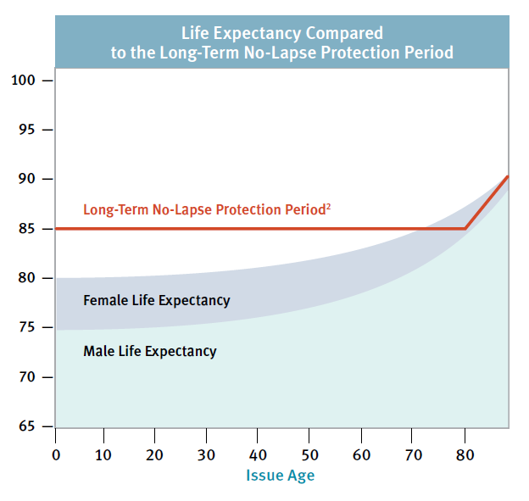
Protection that’s guaranteed
Provides guaranteed coverage to life expectancy – or beyond – for most issue ages
Source: Social Security Administration, Estimates from the 2019 Trustees Report
1 For insureds issue ages 75 and above, this guarantee is provided by paying the short-term no-lapse protection premium. Insureds issue age 80 and over receive a 5-year guarantee.
For producer use only. Not for use with the general public.
Notes:
As we mentioned, paying the long-term no-lapse protection premium provides guaranteed coverage to age 85. So, how meaningful is this guarantee? For most clients who are age 60 and under at issue and are of average health, the long-term no-lapse protection period will take them up to – or even beyond – their life expectancy at issue.
The chart here shows the life expectancy of an average male and an average female and how their life expectancy at issue compares to the long-term no-lapse protection period.

Slide 4
Beyond the guarantee
Beyond age 85
Coverage is available on a non-guaranteed basis
Long-term no-lapse protection premium generally takes the policy to age 120 (based on a 4.5% or higher illustrated rate and non-guaranteed assumptions)
For producer use only. Not for use with the general public.
Notes:
If the insured outlives their life expectancy, the death benefit coverage may extend beyond the long-term no-lapse protection period as long as the policy's surrender value is sufficient to cover the monthly deductions.
For most clients, paying the long-term no-lapse protection premium will generally take the policy to age 120 based on non-guaranteed assumptions and a hypothetical illustrated rate of at least 4.5 percent.
But what happens if the policy doesn’t perform at a rate that is over 4.5 percent?

Slide 5
Beyond the guarantee
The better the index performs, the longer the policy may last based on non-guaranteed assumptions
* Example assumes a male, age 50, Preferred Nontobacco, $500,000 death benefit, paying the long-term no-lapse protection premium.
For producer use only. Not for use with the general public.
Notes:
The better the index performs, the longer the policy may last based on non-guaranteed assumptions. But, even at a more conservative rate, you will find that the coverage typically lasts for a meaningful number of years. This slide shows how long the long-term no-lapse protection premium would last if the policy performed at a more conservative rate of 4 percent. Even at a 4 percent rate, the policy carries to age 103 on a non-guaranteed basis.

Slide 6
How our guarantees compare
(As of April 2017)
For producer use only. Not for use with the general public.
Notes:
If you take a look at this chart, you can see how our long-term no-lapse protection period compares to other carriers’ protection-focused IUL products, as well as how long the death benefit is projected to last based on a 4 and a 4 and a half percent hypothetical rate. At United of Omaha, our premiums are competitive and we also offer a strong no-lapse protection guarantee period.

Slide 7
A little extra reassurance
What if the client wants more certainty?
What if the interest rate doesn’t perform as well as initially illustrated?
Let’s consider Chris…
For producer use only. Not for use with the general public.
Notes:
Since Life Protection Advantage is a protection-focused product, your client may want more certainty that their death benefit will last longer – even if the policy performed at the more conservative rates.
Let’s take a look at our client Chris.

Slide 8
Age 50, Good Health (PNT)
Long-Term No-Lapse Protection Premium = $4,325 annually
Guaranteed to age 85
Projected to age 102 (based on a 5.5% hypothetical rate)
Projected to age 95 (based on a 4.5% hypothetical rate)
For producer use only. Not for use with the general public.
Notes:
Chris is 50 years old and is in good health. He has a need for $500,000 in death benefit protection. His long-term no-lapse protection premium of $4,325 guarantees his coverage will last to age 85 – and is projected to last to age 102 based on a 5.5 percent crediting rate and to age 95 based on a 4.5 percent crediting rate.
But, Chris’s parents are still in great health and his grandparents and great-grandparents lived into their late 90s, so although paying the long-term no-lapse protection premium takes him past his life expectancy, he wants even more certainty that his policy will last as long as he does.

Slide 9
$5,420 annually
Projects to age 120 using a 4.5% illustrated rate
For producer use only. Not for use with the general public.
Notes:
You can show Chris how long his coverage would last if he paid a higher premium. If you solved for the premium that is projected to last to age 120 at a conservative 4.5% illustrated rate, Chris’ death benefit is projected to last until age 120 based on non-guaranteed assumptions

Slide 10
Options for the future
Reduce premiums¹
Stop paying premiums¹
Take distributions from the cash value²
Fixed and index loans are available
1 This is a flexible premium life insurance policy which means clients have the ability to increase or decrease their premium payments, subject to the contract limitations. Before making any changes to the premium, we recommend the client contact the home office to request an inforce illustration to see how a change in premium may impact their policy.
2 The amount that may be available through loans and withdrawals, as defined in the contract.
For producer use only. Not for use with the general public.
Notes:
By paying this extra amount of premium, if the index does perform well, his policy will have extra accumulation. This extra growth can offer him options in the future.
In Chris’s case, as he gets older, if he sees that his actual policy performance is better than what he had originally projected, he has the option to use his policy’s accumulation value to pay for his monthly policy charges, as long as his surrender value is positive. This gives him the flexibility to reduce – or possibly even stop – making premium payments in the future. He also has a cash value that he can access through loans or withdrawals to help supplement retirement income or for emergency expenses, if needed.

Slide 11
The catch-up provision
We allow clients to catch-up and restore their long-term guarantee at any point during the short-term no-lapse protection period as long as the policy hasn't lapsed!
Must pay long-term no-lapse protection premium at issue
For producer use only. Not for use with the general public.
Notes:
One other feature to be aware of is the catch-up provision. The Life Protection Advantage policy allows the client to catch-up and restore their long-term guarantee at any point during the short-term no-lapse protection period as long as the policy hasn't lapsed.
It’s important to remember that in order to do this, the client must pay at least the long-term no-lapse protection premium when they first purchase the policy.

Slide 12
The index interest potential
Option 1
Option 2
Option 3
Option 4
S&P 500®
One-Year 100% Participation
S&P 500®
One-Year High Participation
S&P 500®
One-Year Uncapped
BofA U.S. Agility Index: One-Year Uncapped
For producer use only. Not for use with the general public.
Notes:
We’ve talked a lot about the potential for growth and how that can help extend the death benefit coverage duration. This growth is achieved by basing the index interest crediting rate on the performance of the chosen Index. We also offer a fixed account option. This allows clients to tailor their policy based on how they believe the index will perform.

Slide 13
Which strategy is right for your client?
Strategy | Generally, for clients who:
S&P 500® One-Year 100% Participation | believe the index will perform at an average or slightly above average rate
S&P 500® One-Year High Participation | believe the index will perform below the cap or below the index average
S&P 500® One-Year Uncapped | believe the market will outperform the cap
BofA U.S. Agility Index: One-Year Uncapped | those who desire an index designed to provide more consistent performance in different market environments
Fixed account | may not be comfortable with allocating all of their money to an index interest strategy

Slide 14
How the premiums compare
Consider Jack…
40 years old, good health (PNT)
$500,000 permanent life insurance need
IUL No-Lapse Protection Premium is $2,950
Guaranteed to age 85
Projected to age 120
For producer use only. Not for use with the general public.
Notes:
Since this is a protection-focused product, you may be wondering how the long-term no-lapse protection premium compares to a fully-guaranteed GUL premium. Let’s take a look at a case study. Our client, Jack, is 40 years old and has a $500,000 life insurance need. It’s important to him that his death benefit lasts as long as he does.
Jack can pay approximately $3,500 to $3,750 annually for a fully-guaranteed GUL policy. Paying this premium every year would guarantee coverage for his lifetime (to age 120). In comparison, with a Life Protection Advantage IUL policy, he could pay the long-term no-lapse premium of $2,950.This guarantees his coverage lasts until 85, which is beyond his current life expectancy of age 78.5. At a projected interest rate of 5.5 percent, based on non-guaranteed assumptions, this premium results in death benefit protection that lasts until age 120 with just over $1.2 million in cash value remaining.

Slide 15
Additional IUL benefits
Because of the growth potential, Jack has the ability to:
1035 exchange his surrender value
Reduce or stop paying premiums if his policy performs well¹
Access the cash value² to help supplement retirement income or for emergency expenses
1 This is a flexible premium life insurance policy which means clients have the ability to increase or decrease their premium payments, subject to the contract limitations. Before making any changes to the premium, we recommend the client contact the home office to request an inforce illustration to see how a change in premium may impact their policy.
2 The amount that may be available through loans and withdrawals, as defined in the contract.
For producer use only. Not for use with the general public.
Notes:
In addition to being more affordable than a GUL policy, an IUL also has more potential to accumulate a cash value. That means Life Protection Advantage also offers Jack additional opportunities.
If his needs change, or if a different type of life insurance policy that better meets Jack’s needs is developed, he has a cash surrender value that can be 1035 exchanged into a new policy, assuming Jack is still insurable. Since GUL policies do not typically accumulate much cash value, there is little opportunity to1035 exchange into a different policy in the future, or to access the cash value for emergency expenses
And, if Jack’s policy performs better than what he originally projected, he has also has the option to use his policy’s cash value to pay for his monthly policy charges, as long as the surrender value is positive. And, if Jack needs access to cash to help pay for his children’s college education expenses or to help supplement his retirement income, or for other emergency expenses, he can take a loan or withdrawal from his policy's cash value.

Slide 16
Additional features
Accelerated Death Benefit Riders
Terminal and Chronic Illness
Guaranteed Refund Option (GRO) Rider
Seven 60-day windows to surrender the policy and receive a refund of premiums paid
Up to 50% of their premiums following the 15-year anniversary¹
Up to 100% of premiums at end of years 20, 21, 22, 23, 24 and 25¹
Extra riders at additional cost
1 The refund amount is capped at 50 percent of the policy’s lowest face amount.
For producer use only. Not for use with the general public.
Notes:
Some additional features to be aware of on our Life Protection Advantage IUL policy are the Accelerated Death Benefit Riders for Terminal and Chronic Illness that are included on all policies at no additional charge and with no additional underwriting. We also include the Guaranteed Refund Option rider with all qualifying policies which gives the client seven 60-day windows in which they can get their premiums back upon surrendering their policy.
We’ve been asked occasionally why clients would need a GRO rider on an IUL since it is a product that has the potential for cash value growth. And the fact is that if the client’s policy performed as it was illustrated, they wouldn’t need a GRO rider since their cash value would likely garner significantly more than their premiums paid. However, when the projected cash values aren’t guaranteed, clients tend to be skeptical. That’s where the GRO rider comes in. It provides a guarantee, which offers clients reassurance. It’s an additional layer of protection – especially in an unpredictable market. Should the index not experience positive growth, the policyowner can surrender their policy during one of the seven 60-day windows and receive no less than their GRO rider amount – guaranteed!
There are also a number of other riders that are available for a client to customize their protection. The details for these riders can be found in our product marketing guide, which is available on discoveriul.com.

Slide 17
The target client
Has income replacement, wealth transfer or estate planning needs
Wants to lock-in a death benefit for a meaningful number of years at an affordable premium
Understands the additional years of protection are provided on a non-guaranteed basis
Wants the potential for greater growth than a traditional fixed interest universal life policy can offer
Desires a policy with flexibility for the future
For producer use only. Not for use with the general public.
Notes:
Now that you know how Life Protection Advantage works, you might be wondering who the target client is. It really is for anyone who has a long-term death benefit need such as income replacement, wealth transfer or estate planning.
When looking at the ideal client profile, it is suited for a client who wants to lock-in a death benefit that is guaranteed for a meaningful number of years, but not at the higher cost typically associated with a fully-guaranteed universal life policy; understands the additional years of death benefit protection they need beyond the no-lapse protection period may be extended on a non-guaranteed basis; wants the potential for greater growth than a traditional fixed interest universal life policy can offer and are comfortable with their interest rate being based on the performance of a market index; and desires a policy with flexibility for the future.

Slide 18
Protection Through Life
Visit DiscoverIUL.com for more information
For producer use only. Not for use with the general public.
Notes:
It’s for anyone who wants to provide their loved ones with protection through life.
If you want to learn even more about Life Protection Advantage IUL, go to discoveriul.com. This site has additional information on protection-focused Life Protection Advantage IUL product, along with information on our accumulation-focused product, Income Advantage IUL.

Slide 19
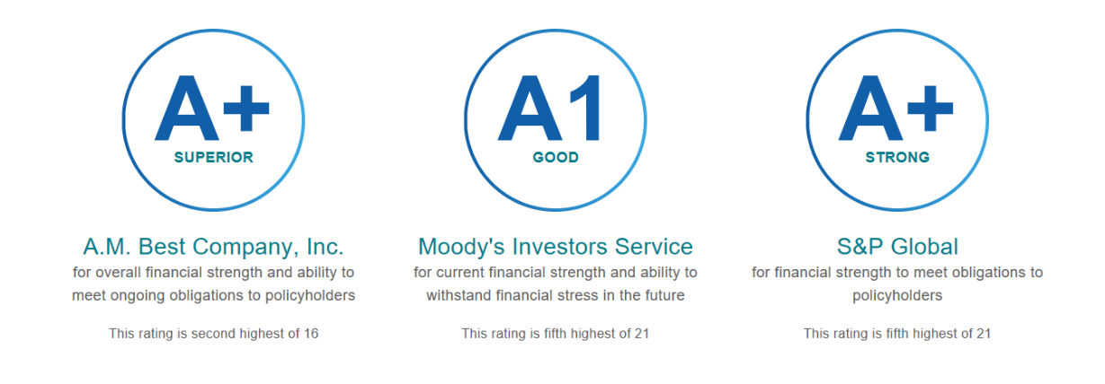
Strong, Stable & Secure for Over 100 Years
Ratings as of July 2023
For producer use only. Not for use with the general public.
Notes:
All of our IUL products are available to you from a company that is strong, stable and secure. We have consistently earned high marks from rating agencies such as A.M. Best, Moody’s Investors Service and Standard & Poor’s.

Slide 20
S&P 500® Index Notice
The “index” is a product of S&P Dow Jones Indices LLC or its affiliates (“SPDJI”) and has been licensed for use by United of Omaha. Standard & Poor’s® and S&P® are registered trademarks of Standard & Poor’s Financial Services LLC (“S&P”) and Dow Jones® is a registered trademark of Dow Jones Trademark Holdings LLC (“Dow Jones”). The trademarks have been licensed to SPDJI and have been sublicensed for use for certain purposes by United of Omaha. Life Protection Advantage ^{sm} is not sponsored, endorsed, sold or promoted by SPDJI, Dow Jones, S&P, or any of their respective affiliates (collectively, “S&P Dow Jones Indices”). S&P Dow Jones does not make any representation or warranty, express or implied, to the owners of Life Protection Advantage or any member of the public regarding the advisability of investing in securities generally or in Life Protection Advantage particularly or the ability of the index to track general market performance. S&P Dow Jones Indices’ only relationship to United of Omaha with respect to the index is the licensing of the index and certain trademarks, service marks and/or trade names of S&P Dow Jones Indices and or its licensors. The index is determined, composed and calculated by S&P Dow Jones Indices without regard to United of Omaha or Life Protection Advantage. S&P Dow Jones indices has no obligation to take the needs of United of Omaha or the owners of Life Protection Advantage into consideration in determining, composing or calculating the index. S&P Dow Jones Indices is not responsible for and has not participated in the determination of the prices, and amount of Life Protection Advantage or the timing of the issuance or sale of Life Protection Advantage or in the determination or calculation of the equation by which Life Protection Advantage is to be converted into cash, surrendered or redeemed, as the case may be. S&P Dow Jones Indices has no obligation or liability in connection with the administration, marketing or trading of Life Protection Advantage. There is no assurance that investment products based on the index will accurately track index performance or provide positive investment returns. S&P Dow Jones Indices LLC is not an investment advisor. Inclusion of a security within an index is not a recommendation by S&P Dow Jones Indices to buy, sell, or hold such security, nor is it considered to be investment advice.
S&P INDICES DOES NOT GUARANTEE THE ADEQUACY, ACCURACY, TIMELINESS AND/OR THE COMPLETENESS OF THE INDEX OR ANY DATA RELATED THERETO OR ANY COMMUNICATION, INCLUDING BUT NOT LIMITED TO, ORAL OR WRITTEN COMMUNICATION (INCLUDING ELECTRONIC COMMUNICATIONS) WITH RESPECT THERETO. S&P DOW JONES INDICES SHALL NOT BE SUBJECT TO ANY DAMAGES OR LIABILITY FOR ANY ERRORS, OMISSIONS, OR DELAYS THEREIN. S&P DOW JONES INDICES MAKES NO EXPRESS OR IMPLIED WARRANTIES, AND EXPRESSLY DISCLAIMS ALL WARRANTIES, OF MERCHANTABILITY OR FITNESS FOR A PARTICULAR PURPOSE OR USE OR AS TO RESULTS TO BE OBTAINED BY UNITED OF OMAHA, OWNERS OF Life Protection ADVANTAGE, OR ANY OTHER PERSON OR ENTITY FROM THE USE OF THE INDEX OR WITH RESPECT TO ANY DATA RELATED TO THERETO. WITHOUT LIMITING ANY OF THE FOREGOING, IN NO EVENT WHATSOEVER SHALL S&P DOW JONES INDICES BE LIABLE FOR ANY INDIRECT, SPECIAL, INCIDENTAL, PUNITIVE, OR CONSEQUENTIAL DAMAGES INCLUDING BUT NOT LIMITED TO, LOSS OF PROFITS, TRADING LOSSES, LOST TIME OR GOODWILL, EVEN IF THEY HAVE BEEN ADVISED OF THE POSSIBILITY OF SUCH DAMAGES, WHETHER IN CONTRACT, TORT, STRICT LIABILITY, OR OTHERWISE. THERE ARE NO THIRD PARTY BENEFICIARIES OF ANY AGREEMENTS OR ARRANGEMENTS BETWEEN S&P DOW JONES INDICES AND UNITED OF OMAHA, OTHER THAN THE LICENSORS OF S&P DOW JONES INDICES.
For producer use only. Not for use with the general public.

Slide 21
Bank of America Disclosure
BofA Securities Inc. and its affiliates (“BofAS”), BofA U.S. Agility Index (the “Index”) and related information, the name “BofAS”, and related trademarks, are intellectual property of BofAS, licensed from BofAS to Mutual of Omaha Insurance Company and United of Omaha Life Insurance Company (collectively, the “Licensee”). Neither the Licensee nor any fixed index annuity, indexed universal life insurance product or any other annuity product (collectively, the “Product”) referencing the Index is sponsored, operated, endorsed, sold or promoted by BofAS. Obligations to make payments under any Product are solely the obligation of Licensee pursuant to the term of the contract between Licensee and you, and are not the responsibility of BofAS. BofAS, the Index and related information, the names of BofAS and its affiliates, and related trademarks may not be copied, used, or distributed without BofAS’s prior written approval. The Products have not been passed on as to their legality or suitability, and are not regulated, issued, endorsed, sold, guaranteed, or promoted by BofAS. BofAS’s only relationship to Licensee is the licensing (or sub-licensing) of certain trademarks and trade names and the Index or components thereof and BofAS is not party to any transaction contemplated herein. While volatility controls may result in less fluctuation in rates of return as compared to products or indices without volatility controls, they may also reduce the overall rate of return as compared to products or indices not subject to volatility controls. BOFAS MAKES NO WARRANTIES AND BEARS NO LIABILITY WITH RESPECT TO THE INDEX, ANY RELATED INFORMATION, THE TRADEMARKS, OR THE PRODUCT(S) (INCLUDING WITHOUT LIMITATION, THEIR QUALITY, ACCURACY, SUITABILITY AND/OR COMPLETENESS)
For producer use only. Not for use with the general public.

